Slide 1
Primitive Roots
Hisham Alkahtani
Azzam Aljariwy

Slide 2
Definition
A number g is primitive root modulo n if every number relatively prime to n is congruent to a power of g modulo n.

Slide 3
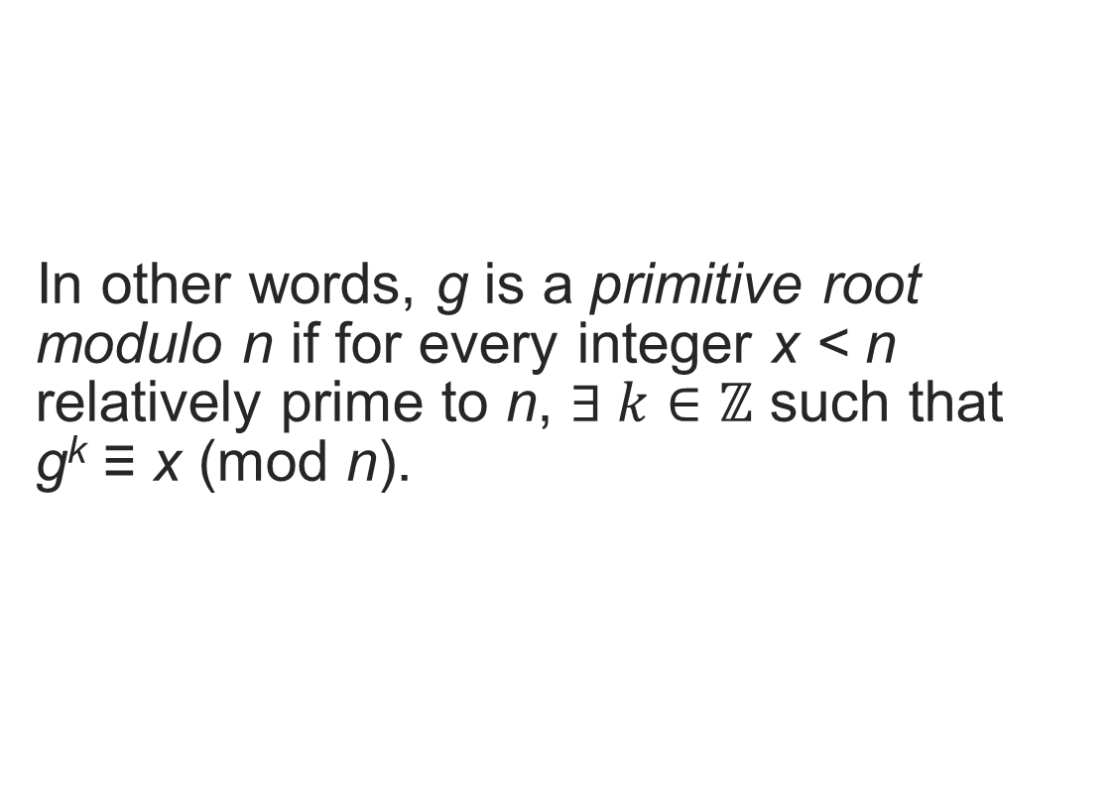
Definition
In other words, g is a primitive root modulo n if for every integer x < n relatively prime to n, $∃ k∈ℤ$ such that g^{k} ≡ x (mod n).

Slide 4

Example: 5 is a primitive root modulo 7 because:
Numbers relatively prime to 7 are {1, 2, 3, 4, 5, 6}
$5^{6}=15625≡1 \left(mod 7\right)$
$5^{4}= 625≡2 \left(mod 7\right)$
$5^{5}=3125≡3\left(mod 7\right)$
$5^{2}=25 ≡4 \left(mod 7\right)$
$5^{1}≡5 \left(mod 7\right)$
$5^{3}=125 ≡6 \left(mod 7\right)$

Slide 5
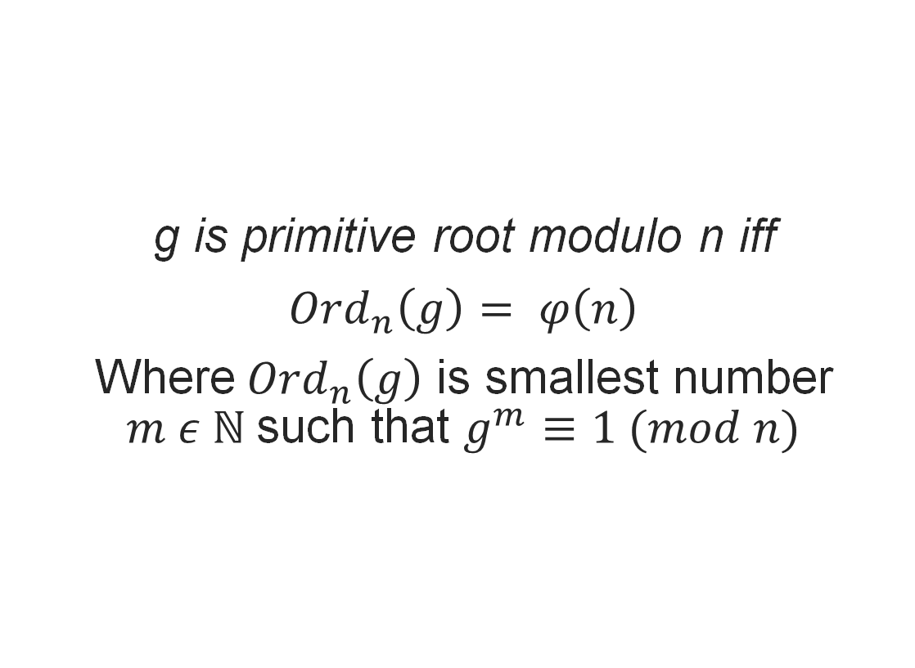
Theorem
g is primitive root modulo n iff
${Ord}_{n}\left(g\right)= φ\left(n\right)$
Where${Ord}_{n}\left(g\right)$ is smallest number $m ε ℕ$such that $g^{m}≡1 (mod n)$

Slide 6
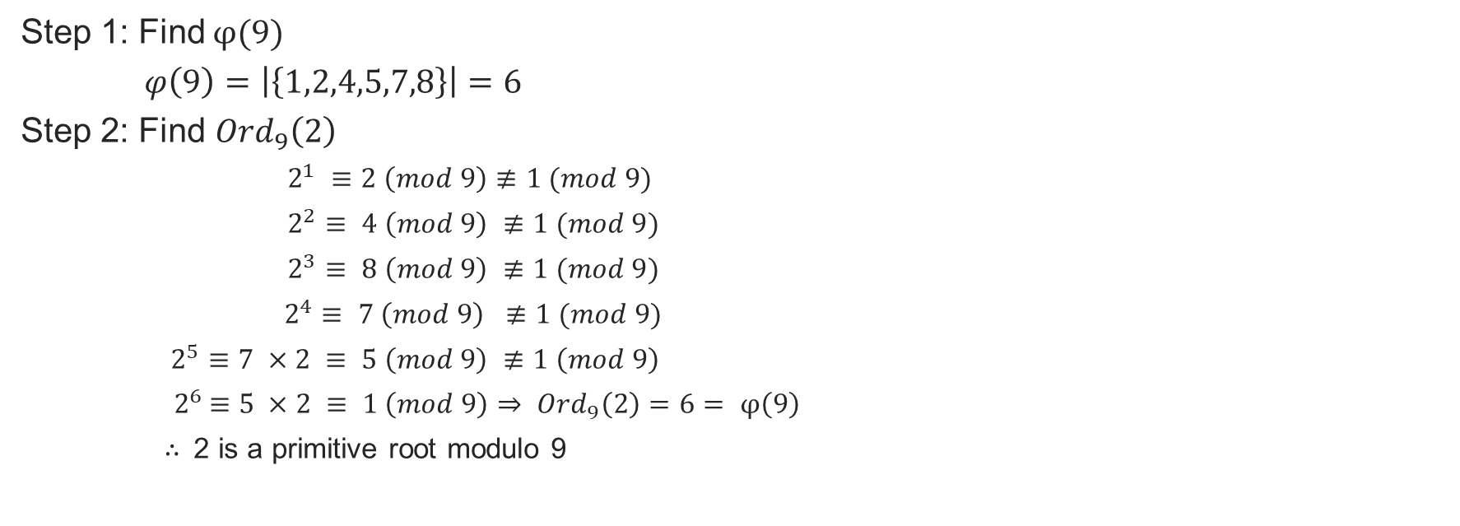
Check if number is primitive root is 2 a primitive root modulo 9?
Step 1: Find $φ(9)$
$φ\left(9\right)=\left|\left\{1,2,4,5,7,8\right\}\right|=6$
Step 2: Find ${Ord}_{9}\left(2\right)$
$2^{1} ≡2 \left(mod 9\right)≢1 (mod 9)$
$2^{2}≡ 4 \left(mod 9\right) ≢1 (mod 9)$
$2^{3}≡ 8 \left(mod 9\right) ≢1 (mod 9)$
$2^{4}≡ 7 \left(mod 9\right) ≢1 (mod 9)$
$2^{5}≡7 ×2 ≡ 5 \left(mod 9\right) ≢1 \left(mod 9\right)$
${ 2}^{6} ≡5 ×2 ≡ 1 \left(mod 9\right)⇒ {Ord}_{9}\left(2\right)=6= φ\left(9\right)$
$∴$ 2 is a primitive root modulo 9
Notes:
Since it’s a primitive root, all powers are distinct in a cycle

Slide 7
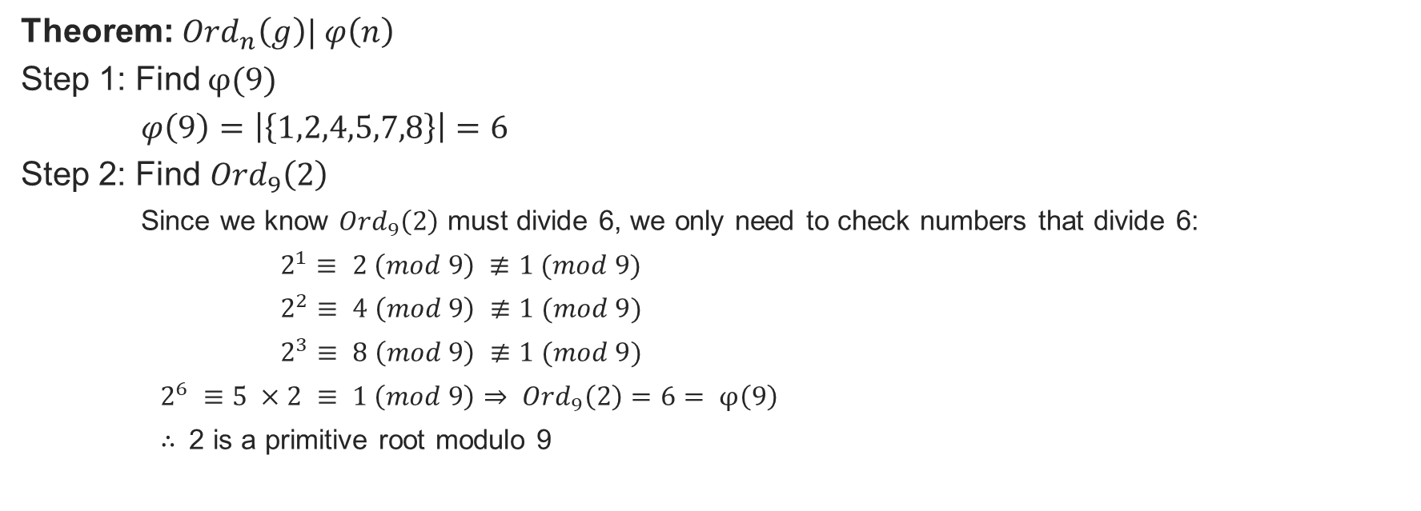
Faster method Is 2 a primitive root modulo 9?
Theorem: ${Ord}_{n}\left(g\right)| φ\left(n\right)$
Step 1: Find $φ(9)$
$φ\left(9\right)=\left|\left\{1,2,4,5,7,8\right\}\right|=6$
Step 2: Find ${Ord}_{9}\left(2\right)$
Since we know ${Ord}_{9}\left(2\right)$ must divide 6, we only need to check numbers that divide 6:
$2^{1}≡ 2 \left(mod 9\right) ≢1 (mod 9)$
$2^{2}≡ 4 \left(mod 9\right) ≢1 (mod 9)$
$2^{3}≡ 8 \left(mod 9\right) ≢1 (mod 9)$
$2^{6} ≡5 ×2 ≡ 1 \left(mod 9\right)⇒ {Ord}_{9}\left(2\right)=6= φ\left(9\right)$
$∴$ 2 is a primitive root modulo 9

Slide 8
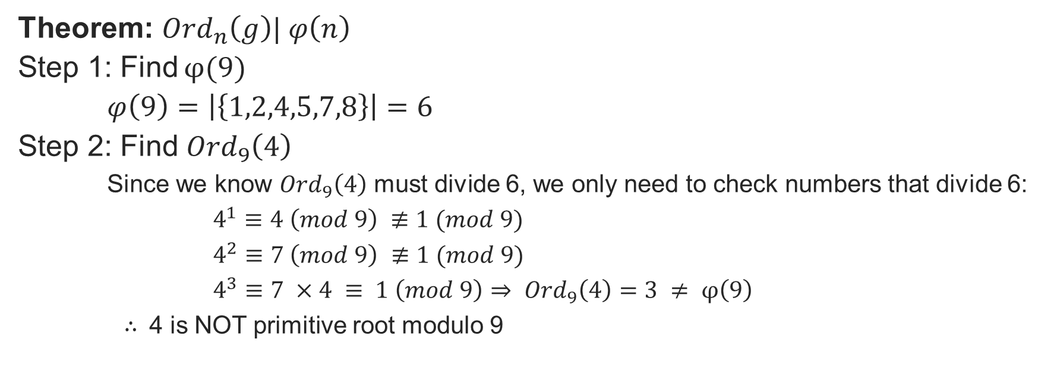
Extra example Is 4 a primitive root modulo 9?
Theorem: ${Ord}_{n}\left(g\right)| φ\left(n\right)$
Step 1: Find $φ(9)$
$φ\left(9\right)=\left|\left\{1,2,4,5,7,8\right\}\right|=6$
Step 2: Find ${Ord}_{9}\left(4\right)$
Since we know ${Ord}_{9}\left(4\right)$ must divide 6, we only need to check numbers that divide 6:
$4^{1}≡4 \left(mod 9\right) ≢1 (mod 9)$
$4^{2}≡7 \left(mod 9\right) ≢1 (mod 9)$
$4^{3}≡7 ×4 ≡ 1 \left(mod 9\right)⇒ {Ord}_{9}\left(4\right)=3 ≠ φ\left(9\right)$
$∴$ 4 is NOT primitive root modulo 9

Slide 9

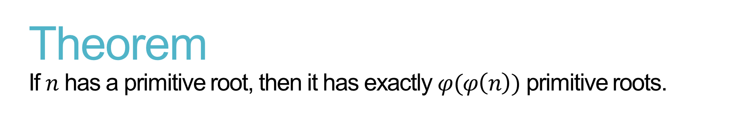
Theorem If $n$ has a primitive root, then it has exactly $φ(φ\left(n\right))$ primitive roots.
Example:
How many primitive roots does 9 have?
$φ\left(φ\left(n\right)\right)⇒φ\left(φ\left(9\right)\right)= φ \left(6\right)=2$
9 has 2 primitive roots (2, 5)

Slide 10
Applications of primitive roots Diffie-Hellman key exchange
Diffie–Hellman key exchange is a method of securely exchanging cryptographic keys over a public channel and was one of the first public-key protocols as conceived by Ralph Merkle and named after Whitfield Diffie and Martin Hellman.
Diffie-Hellman exchange is used in:
Secure Shell (SSH)
Transport Layer Security (TLS)
Internet Proctocol Security (IPSec)

Slide 11
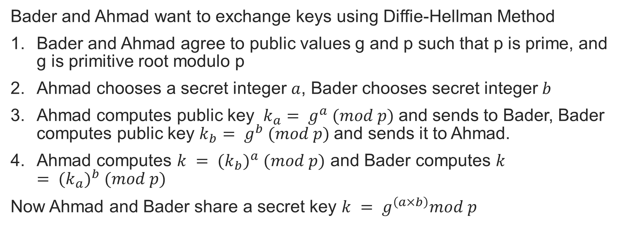
Diffie-Hellman method
Bader and Ahmad want to exchange keys using Diffie-Hellman Method
Bader and Ahmad agree to public values g and p such that p is prime, and g is primitive root modulo p
Ahmad chooses a secret integer $a$, Bader chooses secret integer $b$
Ahmad computes public key $k_{a}= g^{a} (mod p)$and sends to Bader, Bader computes public key $k_{b}= g^{b} (mod p)$and sends it to Ahmad.
Ahmad computes $k = {(k_{b})}^{a} (mod p)$ and Bader computes $k = {(k_{a})}^{b} (mod p)$
Now Ahmad and Bader share a secret key $k = g^{\left(a×b\right)}mod p$

Slide 12
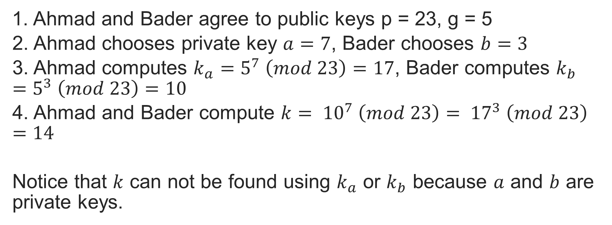
Diffie-Hellman Example
1. Ahmad and Bader agree to public keys p = 23, g = 5
2. Ahmad chooses private key $a=7$, Bader chooses $b=3$
3. Ahmad computes $k_{a}=5^{7} \left(mod 23\right)=17$, Bader computes $k_{b}=5^{3} \left(mod 23\right)=10$
4. Ahmad and Bader compute $k= {10}^{7} \left(mod 23\right)= {17}^{3} \left(mod 23\right)=14$
Notice that $k$ can not be found using $k_{a}$ or $k_{b}$ because $a$ and $b$ are private keys.

